Slide 1

Covid-19 data analysis

Slide 2

Agenda
introduction
Problem statement
Problem solving Strategy
Insights
Problems encountered
Future scope

Slide 3

Introduction

Slide 4

problem statement
Covid 19 second wave was much more devastating for India than the first wave, with shortages of hospital beds, vaccines, oxygen cylinders, and other medical supplies. Analyzing the covid19 data will help better prepare to deal with future threats.

Slide 5
strategy
It is important to know how each state is performing. So, we have made a state-wise analysis by comparing different factors like death rate, percentage of population vaccinated, confirmed cases and recovered cases.

Slide 6
PHASES
Get data from the API using requests module
Data cleaning
Using pandas
Analysing the data using SQL
Data visualization
Using Excel

Slide 7
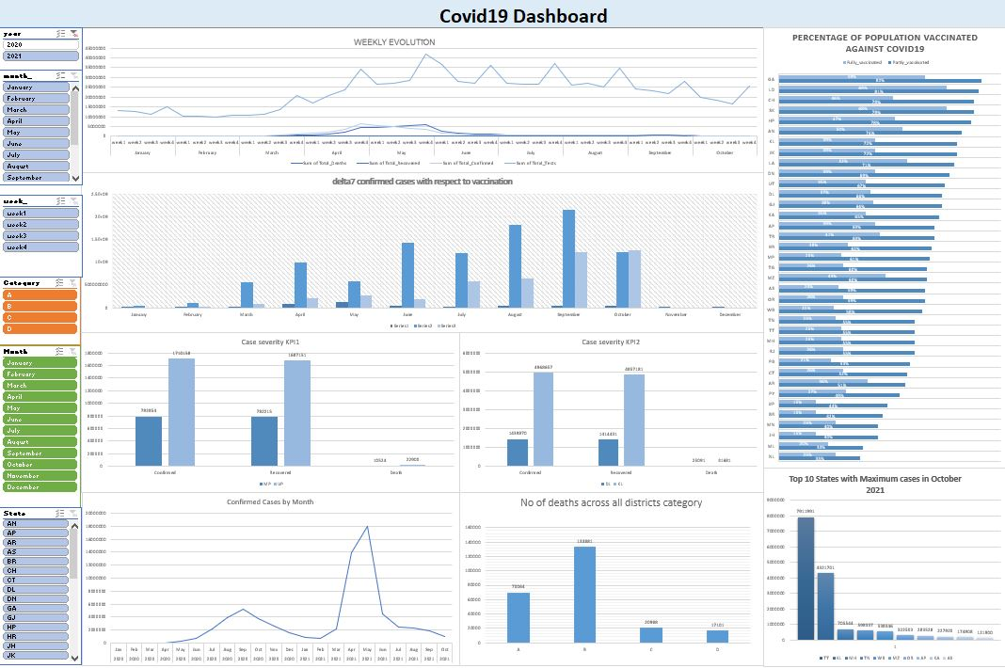

Slide 8
insights

Slide 9
The chart shows the share of
the percentage of the population got
Vaccinated.
As you can see in that chart,
states like Nagaland,
Meghalaya only 40 %
of population
that has received at least one dose.

Slide 10
Both Vaccinated1 & Vaccinated2 greater than 50%
Vaccinated1 greater than 50% and Vaccinated2 less than 50%

Slide 11
This chart provides a clearer picture of where the number of death is accelerating,
slowing, or in fact reducing.
As you can see that the death rate were accelerating from 4th week of may.
The death rate was much higher between 4th week of April and 2nd week of June.

Slide 12
We categorized districts based on the testing ratio.
Testing ratio = Number of tests done/ Population
As you can see from the chart, the category B districts have more deaths.

Slide 14
We compared the case severity between MP and UP
As you can see from the chart the severity of the case in UP is high compared to MP.

Slide 15
We compared the case severity between Kerala and Delhi.
As you can see from the chart the severity of the case in Kerala is high compared to Delhi.

Slide 16
From the chart, we can see that India reported more cases
in May month.

Slide 17
Challenges faced
As all of our team members are working professionals, we were finding difficulty in managing time
and the time availability of each team member is different.
Firstly, we brainstormed and formed a flowchart of works that helped us be on track.
We allocated the work according to each person’s time availability and task priority.

Slide 18


Thank you

